Slide 1
Bristol Myers Squibb has obtained appropriate permissions to externally share this material with Healthcare Professionals upon request.

Slide 2
BMS-986458, a first-in-class, bifunctional, cereblon-dependent ligand-directed degrader of B-cell lymphoma 6 (BCL6) in patients with relapsed/refractory non-Hodgkin lymphoma: initial phase 1 results
Franck Morschhauser,¹ David Qualls,² Jennifer Lue,³ Anastasios Stathis,⁴ Marcel Nijland,⁵ Noémie Lang,⁶ Jörg Bittenbring,⁷ Guillaume Cartron,⁸ Avyakta Kallam,⁹ Loïc Ysebaert,¹⁰ Vladan Vucinic,¹¹ Jonathan Kolitz,¹² Noelia Purroy,¹³ Bérengère de Moucheron,¹⁴
Alicia Benítez Rondán,¹⁴ Joseph Burnett,¹³ Carla Guarnios,¹⁴ Xiaosong Li,¹³
Michael Pourdehnad,¹⁵ Thomas Hueso¹⁶
¹Hôpital Claude Huriez – CHU de Lille, Lille, France; ²Dana-Farber Cancer Institute, Boston, MA, USA; ³Memorial Sloan Kettering Cancer Center, New York,
NY, USA; ⁴Oncology Institute of Southern Switzerland, EOC, Bellinzona, Switzerland; ⁵University Medical Center Groningen, Groningen, The Netherlands; ⁶Hôpitaux Universitaires de Genève (HUG), Geneva, Switzerland; ⁷Universitätsklinikum des Saarlandes, Homburg, Germany; ⁸CHU de Montpellier, Montpellier, UMR-CNRS 5535, France; ⁹City of Hope Comprehensive Cancer Center, Duarte, CA, USA; ¹⁰Institut Claudius Regaud, Toulouse, France; ¹¹Universitätsklinikum Leipzig, Leipzig, Germany; ¹²Northwell Health/RJ Zuckerberg Cancer Center, Lake Success, NY, USA; ¹³Bristol Myers Squibb, Princeton, NJ, USA;
¹⁴Bristol Myers Squibb, Center for Innovation and Translational Research Europe (CITRE), Seville, Spain; ¹⁵Bristol Myers Squibb, Early Clinical Development, Hematology/Oncology and Cell Therapy, San Francisco, CA, USA; ¹⁶Institut Gustave Roussy, Villejuif, France
Presentation number 091

Slide 3
Disclosures for Franck Morschhauser
  Consultancy fees
    Bristol Myers Squibb, Gilead, AbbVie, Roche, Janssen
  Honoraria
    Takeda, Chugai, AstraZeneca
  Monitoring and advisory boards
    Roche, Miltenyi, Modex Therapeutics, AstraZeneca

Slide 4
Introduction
  Approximately 20%–50% of patients with DLBCL or FL experience R/R disease, which is associated with poor outcomes^{1–3}
  BCL6 is a transcriptional repressor required for tolerance of immunoglobulin hypermutation and normal B-cell maturation; it inhibits cell cycle arrest and DNA damage checkpoints, and prevents apoptosis⁴
Along with BCL2 and c-Myc, BCL6 is one of the most frequently genetically misregulated proteins in DLBCL (~20%–40%)^{4,5}
  BMS-986458 is a first-in-class, oral, highly selective, cereblon-dependent ligand-directed degrader of BCL6⁶
  Here, we present the first clinical findings from the dose-escalation part of CA123-1000 (NCT06090539), a first-in-human, multicenter, open-label, phase 1/2 study of BMS-986458 in patients with R/R NHL
BCL2, B-cell lymphoma/leukemia-2; BCL6, B-cell lymphoma 6; DLBCL, diffuse large B-cell lymphoma; FL, follicular lymphoma; NHL, non-Hodgkin lymphoma; R/R, relapsed or refractory.
1. Coiffier B, et al. Blood 2010;116:2040–2045. 2. Casulo C, et al. J Clin Oncol 2015;33:2516–2522. 3. Crump M, et al. Blood 2017;130;1800-1808. 4. Basso K and Dalla-Favera R. Nat Rev Immunol 2015;15:172-184. 5. Grau M, et al. Best Pract Res Clin Haematol 2023;36:101513. 6. Groocock L, et al. Oral presentation at the American Society of Hematology (ASH) Annual Meeting 2024; December 5-10, 2024; San Diego, CA. Abstract 957.

Slide 5







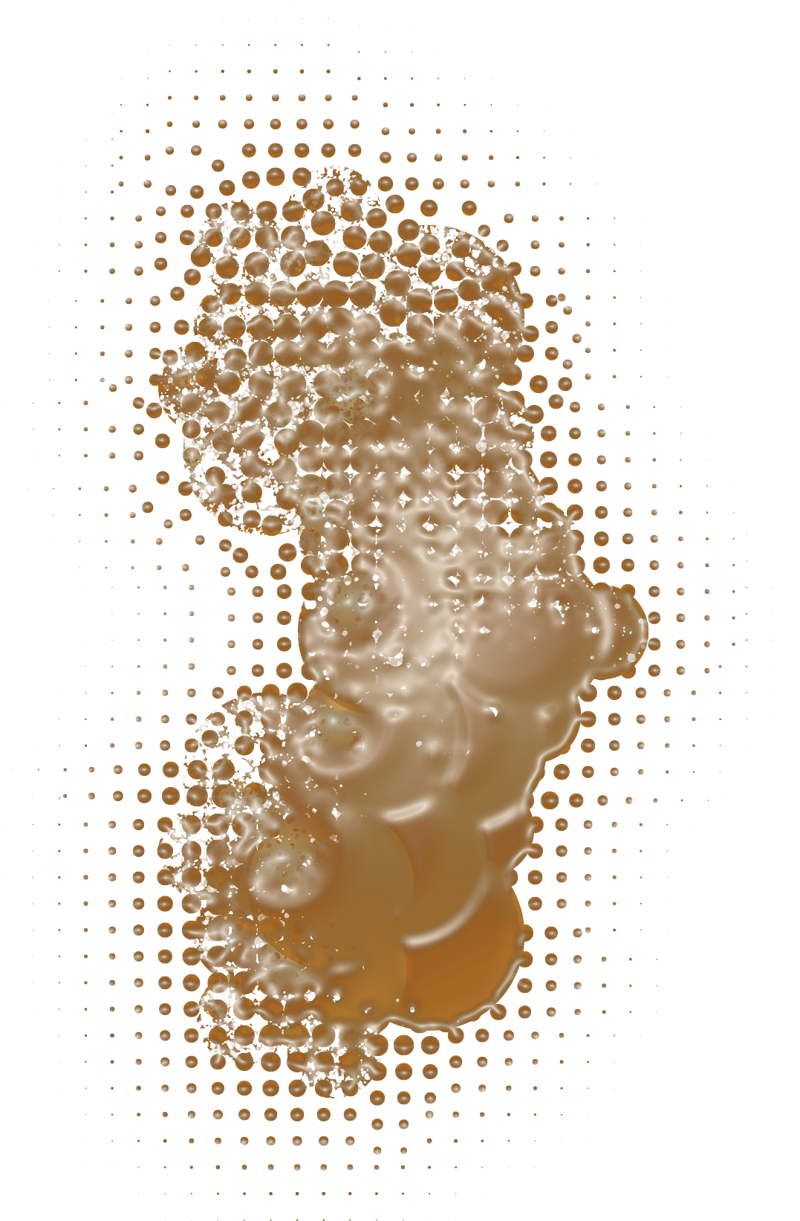




BMS-986458 is a first-in-class, highly selective, BCL6 degrader¹
BMS-986458-mediated BCL6 degradation occurs through recruitment of the
CRBN E3 ligase, ubiquitination, and subsequent proteolytic processing
by the proteasome
BMS-986458-mediated degradation of
BCL6 leads to anti-proliferation and apoptosis of tumor B cells, and
immune modulation
    In vitro, BMS-986458 phenotypically
    modulates Tfh and Treg cells without
    affecting cell viability
BMS-986458
Proteasome
CRBN-
binding domain
BCL6-
binding domain
Tumor regression
BCL6
CRBN
E2
Ub
E3
E2
DDB1
RBX1
CUL4A
BCL6 degradation
Tumor B-cell anti-proliferation/apoptosis
Immune modulation in the TME
BCL6, B-cell lymphoma 6; CRBN, cereblon; CUL4A, cullin 4A; DDB1, DNA damage-binding protein 1; RBX1, RING-box protein 1; Tfh, T follicular helper cells; TME, tumor microenvironment;
Treg, regulatory T cells; Ub, ubiquitin.
1. Groocock L, et al. Oral presentation at the American Society of Hematology (ASH) Annual Meeting 2024; December 5-10, 2024; San Diego, CA. Abstract 957.

Slide 6
Phase 1/2 study (CA123-1000): dose escalation of BMS-986458 in patients with R/R NHL¹
Key inclusion criteria
Single agent escalation (N = 31)
Objectives
Patients with R/R DLBCL with
≥ 2 prior regimens
  Patients who exhausted or were ineligible for available therapy (including CAR T cell therapy and bispecific monoclonal antibodies) or were unwilling to receive them
Patients with R/R FL (including
FL 3B) with ≥ 2 prior regimens
Measurable disease, as defined by the Lugano classification
of NHL²
Primary: to evaluate the safety and tolerability of BMS-986458 and determine the RP2D
Secondary: to characterize BMS-986458 plasma PK and assess preliminary efficacyª
BID
QD
160 mg
n = 4
260 mg
n = 7
80 mg
n = 3
160 mg
n = 6
40 mg
n = 5
80 mg
n = 6
ªThe efficacy-evaluable population included patients who received ≥ 1 dose of BMS-986458, had undergone baseline and post-baseline tumor assessment, had experienced clinical disease progression, or died. Cutoff date: April 10, 2025. BID, twice daily; DLBCL, diffuse large B-cell lymphoma; FL, follicular lymphoma; NHL, non-Hodgkin lymphoma; PK, pharmacokinetics;
QD, once daily; R/R, relapsed/refractory; RP2D, recommended phase 2 dose.
1. ClinicalTrials.gov. NCT06090539. https://www.clinicaltrials.gov/study/NCT06090539 Accessed May 9, 2025. 2. Cheson BD, et al. J Clin Oncol 2014;32:3059–3068.

Slide 7
Patient disposition
Enrolled
(N = 31)
Discontinued therapy (n = 17, 54.8%)
Progressive disease (n = 10, 32.3%)
Adverse event (n = 5, 16.1%)
Withdrawal of consent patient (n = 1, 3.2%)
Death (n = 1, 3.2%)
Ongoing
(n = 14, 45.2%)
Median follow-up for treated patients was 2.8 months (range, 0.3–11.7)
Cutoff date: April 10, 2025.

Slide 8
Patient characteristics: a heavily pre-treated population
 | N = 31
Age, years, median (range) | 62 (26–76)
Sex, n (%) Female Male | 10 (32.3) 21 (67.7)
Disease stage at entry, n (%) Stage I Stage II Stage III Stage IV Unknown | 2 (6.5) 4 (12.9) 5 (16.1) 18 (58.1) 2 (6.5)
Disease typeª, n (%) DLBCL (not otherwise specified) DLBCL/high-grade BCL (all triple-hit) FL | 14 (45.2) 5 (16.1) 10 (32.3)
Cell of origin, n (%) ABC, non-GCB GCB Unknown | 5 (16.1) 7 (22.6) 9 (29.0)
Risk category for IPI (DLBCL), n/N (%) High (3–5) Low-intermediate (2) Low (0–1) | 7/19 (36.8) 9/19 (47.4) 3/19 (15.8)
 | N = 31
Risk category for FLIPI (FL), n/N (%) High (3–5) Intermediate (2) Low (0–1) Unknown | 6/10 (60.0) 1/10 (10.0) 2/10 (20.0) 1/10 (10.0)
ECOG PS, n (%) 0 1 | 11 (35.5) 20 (64.5)
Prior lines of therapy, n (%) 2 3 ≥ 4 | 4 (12.9) 6 (19.4) 21 (67.7)
Median of prior lines of therapy (range) | 4 (2-12)
Types of prior anticancer therapy, n (%) CAR T cell therapy Bi-/tri-specific mAb IMiD/CELMoD™ agent | 24 (77.4) 18 (58.1) 19 (61.3)
Refractory to prior therapy, n (%) | 22 (71.0)
ªTwo patients with high-grade BCL were entered after data cutoff. Cutoff date: April 10, 2025. ABC, activated B-cell-like; CELMoD, cereblon E3 ligase modulator; DLBCL, diffuse large
B-cell lymphoma; ECOG PS, Eastern Cooperative Oncology Group performance status; FL, follicular lymphoma; FLIPI, Follicular Lymphoma International Prognostic Index; GCB, germinal
center B-cell-like; IMiD, immunomodulatory imide drug; IPI, International Prognostic Index; mAb, monoclonal antibody.

Slide 9
BMS-986458 was well tolerated with mainly low-grade adverse events
Most frequent TRAEs and TEAEs (≥ 3 patients in either category)ª
TRAEs
TEAEs
  Most common TRAEs were arthralgia (n = 6, 19.4%)
  and fatigue (n = 5, 16.1%)
    Grade 3/4 TRAEs occurred in 5 (16.1%) treated patients
      Pneumonia, arthritis, bone pain, peripheral neuropathy, prolonged QT interval (n = 1 each), and myalgia (n = 2)
    Serious TRAEs occurred in 2 (6.5%) patients
      Pneumonia and prolonged QT interval (n = 1 each)
    No grade ≥ 3 hematologic TRAEs, and no dose discontinuations or deaths due to TRAEs
  TEAEs led to dose interruption in 15 (48.4%) patients, dose reduction in 2 (6.5%) patients, and discontinuation in 5 (16.1%) patients
  A total of 2/25 (8%) experienced a DLT^{b}
    DLTs were arthritis and bone pain in one patient dosed at 40 mg twice daily (BID), and a prolonged QT interval in a patient dosed at 260 mg once daily (QD)
Anemia
Fatigue
Arthralgia
Hypercalcemia
Pyrexia
Diarrhea
Nausea
Cough
Constipation
Headache
Peripheral neuropathy
Pneumonia
Grade 1
Hemorrhoids
Grade 2
Bronchitis
Grade 3
Decreased appetite
Peripheral edema
Grade 4
Pain in extremity
Grade 5
Myalgia
Neutropenia
Cutoff date: April 10, 2025. ªn = 31 enrolled patients; ^{b}n = 25 DLT-evaluable patients
DLT, dose-limiting toxicity; TEAE, treatment-emergent adverse event; TRAE, treatment-related adverse event.

Slide 10
BID and QD dosing of BMS-986458 produced efficacious exposures on day 1 and at steady state
Day 1
Day 15
260 mg QD
160 mg BID
160 mg QD
1000
80 mg BID
80 mg QD
40 mg BID
20 mg BID
Mean concentration (ng/mL)
100
10
0
5
10
15
20
25
0
5
10
15
20
25
Time after dose (H)
Solid dots represent mean plasma concentration at nominal collection time, displayed on a semi-logarithmic scale. Upper error bar represents standard deviation and lower error bars have been omitted for clarity. The dotted lines indicate trough exposures predicted to be efficacious.
Cutoff date: April 10, 2025.
BID, twice daily; H, hour; QD, once daily.

Slide 11
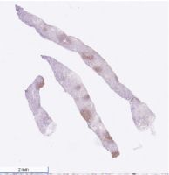
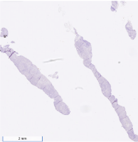
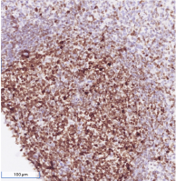
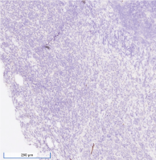
BMS-986458 induces rapid and sustained BCL6 degradation in peripheral blood and in the tumor
BCL6 degradation in peripheral blood monocytes by flow cytometry
BCL6 expression by IHC in a patient with CR and a diagnosis of FL
20
Screening | C1D13
60% | 0%
% of BCL6-positive tumor cells
0
40 mg BID
40 mg BID
−20
80 mg QD
80 mg QD
80 mg BID
80 mg BID
160 mg QD
BCL6 (percent change from baseline)
160 mg QD
−40
160 mg BID
160 mg BID
260 mg QD
−60
260 mg QD
2 mm
2 mm
−80
−100
Screening
C1D1
(0H)
C1D1
(5H)
C1D2
(0H)
C1D8
(0H)
C1D8
(5H)
C1D15
(0H)
C1D15
(5H)
Time of measurement
The maximum detectable degradation of BCL6 in peripheral blood was observed at all doses evaluatedª
100 µm
200 µm
ªThe maximum detectable degradation of BCL6 during assay validation was 80%. Cutoff date: April 10, 2025.
BCL6, B-cell lymphoma 6; BID, twice daily; C, cycle; CR, complete response; D, day; FL, follicular lymphoma; H, hour; IHC, immunohistochemistry; QD, once daily.

Slide 12

BMS-986458 induces deep and rapid antitumor activity
BMS-986458 resulted in deep responses across dose levels in patientsª with DLBCL and FL
ORR = 81.0% (17/21), CR = 23.8% (5/21), PR = 57.1% (12/21)
    One patient with triple-hit status achieved a CR
    In patients with DLBCL, ORR = 80% (12/15),
    CR = 7% (1/15)
    In patients with FL, ORR = 83% (5/6),
    CR = 67% (4/6)
Among responders, the median (range):
    Time to first objective response = 1.77 (1.6–2.4) months
    Duration of response = 3.71 (1.15–NR) months
80
60
40
DLBCL
FL
20
0
Best percent change from baseline
−20
−40
−60
−80
−100
40
80
40
160
40
160
260
260
80
160
80
40
80
160
160
160
80
160
260
40
160
BID
QD
BID
BID
BID
QD
QD
QD
QD
QD
BID
BID
BID
QD
BID
BID
BID
QD
QD
BID
QD
Dosage (mg)
Skin tumor lesions showed rapid clinical response in a patient with CR^{b}
C1D1
5.2 x 5.2 cm
C1D8
3.8 x 3.0 cm
C1D15
3.5 x 2.8 cm
C1D22
3.0 x 1.5 cm
C2D1
3.0 x 1.0 cm
ªEfficacy-evaluable population. ^{b}The images come from a 66-year-old male diagnosed with high-grade B-cell lymphoma (MYC+/BCL2+/BCL6+), GCB, transformed from prior FL, stage IV, IPI 4–5. Prior treatments for high-grade B-cell lymphoma were ibrutinib + venetoclax, CAR T cell therapy, epcoritamab + venetoclax + ibrutinib + lenalidomide, and loncastuximab. BOR was PR. The patient received BMS-986458 160mg BID, at C1D8 clinical improvement of skin lesions, and at C3D1 partial metabolic response. Cutoff date: April 10, 2025. BCL6, B-cell lymphoma 6; BID, twice daily;
BOR, best overall response; C, cycle; D, day; DLBCL, diffuse large B-cell lymphoma; FL, follicular lymphoma; GCB, germinal center B-cell–like; IPI, International Prognostic Index; NR, not reached;
ORR, objective response rate; PR, partial response; QD, once daily.

Slide 13
Conclusions
BMS-986458 was tolerable in patients with R/R NHL, with mainly low-grade adverse events,
no grade ≥ 3 treatment-related cytopenias, and no treatment discontinuations due to TRAEs
BMS-986458 induced a rapid and sustained degradation of BCL6 in peripheral blood monocytes and
in the tumor
Strong antitumor activity was confirmed in heavily pretreated patients with DLBCL and FL
    Response rates were favorable, with an ORR of 81% (80% in DLBCL and 83% in FL) and a CR rate of approximately 24% (7% in DLBCL and 67% in FL)
Overall, in these initial phase 1 results, BMS-986458 showed promising preliminary efficacy and acceptable tolerability in heavily pre-treated R/R DLBCL and FL, supporting its continued development as monotherapy or combination therapy for NHL
BCL6, B-cell lymphoma 6; CR, complete response; DLBCL, diffuse large B-cell lymphoma; FL, follicular lymphoma; NHL, non-Hodgkin lymphoma; ORR, objective response rate;
R/R, relapsed or refractory; TRAE, treatment-related adverse event.

Slide 14

Acknowledgments
  We thank the patients and families who made this study possible, and the clinical teams who participated
  The study was funded by Bristol Myers Squibb
  Professional medical writing assistance was provided by Sandra Page, PhD, Thierry Deltheil, PhD, and
  Laura McArdle, BA, of Spark (a division of Prime, New York, USA), funded by Bristol Myers Squibb
To request a copy of this presentation, scan the quick response (QR) code below via a barcode reader application
Access this presentation via the QR code
Please note: Photography is strictly prohibited
Links are valid for 30 days after the congress presentation date
Copies of this slide deck obtained through the QR code are for personal use only and may not be reproduced without permission from ICML® or the author of these slides.

