Slide 1
Bristol Myers Squibb has obtained appropriate permissions to externally share this material with Healthcare Professionals upon request.

Slide 2
Overall survival and duration of transfusion independence for first-line ESA-naive patients with lower-risk myelodysplastic syndromes treated with luspatercept versus epoetin alfa in the COMMANDS trial
Valeria Santini,¹ Matteo Giovanni Della Porta,² Amer M. Zeidan,³ Rami S. Komrokji,⁴ Veronika Pozharskaya,⁵ Shelonitda Rose,^{5,*} Karen L. Keeperman,⁵ Yinzhi Lai,⁵
Sameer Kalsekar,⁶ Barkha Aggarwal,⁵ Dimana Miteva,⁷ David Valcárcel,⁸
Pierre Fenaux,⁹ Jake Shortt,¹⁰ Uwe Platzbecker,¹¹ Guillermo Garcia-Manero¹²
¹University of Florence, Florence, Italy; ²Cancer Center IRCCS Humanitas Research Hospital, Milan, Italy; Humanitas University, Milan, Italy; ³Yale University School of Medicine, New Haven, CT, USA; ⁴Moffitt Cancer Center, Tampa, FL, USA; ⁵Bristol Myers Squibb, Princeton, NJ, USA; ⁶Bristol Myers Squibb, Hyderabad, Telangana, India; ⁷Bristol Myers Squibb, Boudry, Switzerland; ⁸Hospital Universitari Vall d'Hebron, Barcelona, Spain; ⁹Hôpital Saint-Louis, Université Paris 7, Paris, France; ¹⁰Monash University and Monash Health, Melbourne, VIC, Australia; ¹¹University Hospital Leipzig, Leipzig, Germany; ¹²University of Texas M.D. Anderson Cancer Center, Houston, TX, USA
*At the time of the study.
EHA 2025, Abstract S177

Slide 3
Disclosures
President of the Scientific Committee of Fondazione Italiana per lo studio delle sindromi mielodisplastiche (FISiM) and Italian Network of MDS Registries
Vice President of the Italian Society of Hematology (SIE)
Medical scientific board member of AA&MDS International Foundation
Editorial board member of Blood Neoplasia and Leukemia
Consulting/advisory board member to AbbVie, Ascentage, Bristol Myers Squibb, Geron, GSK, Keros, Novartis, Otsuka, Servier, and Syros
Travel support: Janssen and Jazz Pharmaceuticals
This oral presentation, in part, was previously presented at the 2025 ASCO Annual Meeting

Slide 4
COMMANDS: background and objective
Luspatercept is an erythroid-maturation agent that improves erythropoiesis^{1,2}
The primary analysis of the phase 3 COMMANDS trial (NCT03682536) showed superior efficacy of luspatercept versus epoetin alfa, with sustained and durable clinical benefit for the treatment of anemia among ESA-naive patients with transfusion-dependent LR-MDS^{3,4}
The results of the COMMANDS trial led to the approval of luspatercept for the first-line treatment of anemia in ESA-naive patients with LR-MDS who may require transfusions⁵
Objective: To report, for the first time, OS and updated long-term duration of response and safety results from the COMMANDS trial, with a median follow-up of > 2.5 years
ESA, erythropoiesis-stimulating agent; LR-MDS, lower-risk myelodysplastic syndromes; OS, overall survival.
1. Attie KM et al. Am J Hematol. 2014;89:766–770. 2. Suragani RNVS et al. Nat Med. 2014;20:408-414. 3. Della Porta MG et al. Lancet Hematol. 2024;11:e646-e658. 4. Garcia-Manero G et al. Blood. 2024;144(Supplement 1):350. 5. Reblozyl® (luspatercept-aamt) [prescribing information]. Bristol Myers Squibb; May 2024.
Notes:
Shivani Srivastava:
May consider spelling out TD, lesser known acronym.

Slide 5
COMMANDS: study design
COMMANDS (NCT03682536) is a global, phase 3, open-label, randomized controlled trial
Key patient eligibility criteria
≥ 18 years of age
IPSS-R very low-, low-, or intermediate-risk MDS (with or without RS) by WHO 2016 classification, with < 5% BM blastsª
Required RBC transfusions (2–6 pRBC U/8 weeks, minimum of 8 weeks prior to randomization)
ESA-naive
Endogenous sEPO < 500 U/L
Patients stratified by
Baseline RBC transfusion burden (< 4 or ≥ 4 pRBC U/8 weeks)
Baseline endogenous sEPO level (≤ 200 or > 200 U/L)
RS status (RS+ or RS–)
End of treatment
Due to lack of clinical benefit^{c} or disease progression per IWG 2006 criteria
Post-treatment safety follow-up
Monitoring for other malignancies, HR-MDS or AML progression, subsequent therapies, and survival for 5 years from first dose
Primary endpoint
RBC-TI for ≥ 12 weeks (Weeks 1-24) with concurrent mean Hb increase ≥ 1.5 g/dL
Secondary endpoints
RBC-TI for ≥ 12 weeks (Weeks 1-24)
Duration of RBC-TI ≥ 12 weeks
OS
Progression to AML
Safety
Luspatercept
1.0 mg/kg SC Q3W titration up to 1.75 mg/kg (n = 182)
R
1:1
Epoetin alfa^{b}
450 IU/kg SC QW titration up to 1050 IU/kg (n = 181)
Response assessments at Day 169 and then every 24 weeks thereafter
AML, acute myeloid leukemia; BM, bone marrow; Hb, hemoglobin; HR-MDS, higher-risk MDS; IPSS-R, International Prognostic Scoring System-Revised; IU, international units; IWG, International Working Group; pRBC, packed red blood cell; Q3W, once per 3 weeks; QW, once per week; R, randomized; RBC, red blood cell; RBC-TI, red blood cell-transfusion independence; RS, ring sideroblast; SC, subcutaneously; sEPO, serum erythropoietin; U, units; WHO, World Health Organization.
ªPatients with del(5q) were excluded. ^{b}2 patients randomized to the epoetin alfa arm withdrew consent prior to receiving their first dose. ^{c}Clinical benefit was defined as transfusion reduction of ≥ 2 pRBC U/8 weeks versus baseline.
Della Porta MG et al. Lancet Hematol. 2024;11:e646-e658.

Slide 6
COMMANDS: baseline characteristics¹ and patient disposition
Baseline characteristics at the time of data cutoff (March 31, 2023) | Luspatercept (n = 182) | Epoetin alfa (n = 181)
Median age (IQR), years | 74.0 (68-80) | 74.0 (69-80)
Sex, n (%) Male Female | 109 (59.9) 73 (40.1) | 92 (50.8) 89 (49.2)
Median Hb (IQR), g/dL | 7.8 (7.1-8.2) | 7.8 (7.1-8.3)
Median TB (IQR), RBC U/8 weeks | 3.0 (2.0-4.0) | 3.0 (2.0-4.0)
TB category, n (%)
< 4 U/8 weeks | 118 (64.8) | 111 (61.3)
≥ 4 U/8 weeks | 64 (35.1) | 70 (38.7)
Median time since original MDS diagnosis (IQR),ª months | 8.0 (2.0-28.8) | 5.1 (1.6-16.8)
sEPO category, n (%)
≤ 200 U/L | 145 (79.7) | 144 (79.6)
> 200 to < 500 U/L | 37 (20.3) | 37 (20.4)
SF3B1 mutation status, n (%)
Mutated | 114 (62.6) | 101 (55.8)
Non-mutated | 65 (35.7) | 72 (39.8)
RS status, n (%)
Positive | 133 (73.1) | 130 (71.8)
Negative | 49 (26.9) | 50 (27.6)
Charlson Comorbidity Index,^{b,c} mean (SD) | 1.2 (1.0) | 1.1 (1.2)
Patient disposition at the time of data cutoff (February 7, 2025) | Luspatercept (n = 182) | Epoetin alfa (n = 181)
Median follow-up (range), months Median treatment duration (range),^{d} weeks Patients still on treatment, n (%) Patients with ≥ 1 dose escalation,^{d} n (%) Total number of deaths on and post-treatment,^{d} n (%) | 30.6 (1-65) 71.5 (3-276) 41 (22.5) 154 (84.6) 59 (32.4) | 28.8 (0-69) 44.0 (1-299) 18 (10.1) 149 (83.2) 69 (38.5)
IQR, interquartile range; TB, transfusion burden.
ªTime since diagnosis of MDS was defined as the number of months from the date of diagnosis to the date of informed consent for the trial. ^{b}Derived from medical history data. ^{c}Data cutoff February 7, 2025. ^{d}Among the safety population (luspatercept, n = 182; epoetin alfa, n = 179), defined as all randomized patients who received ≥ 1 dose of study treatment (and by treatment received).
1. Della Porta MG et al. Lancet Hematol. 2024;11:e646-e658.

Slide 7
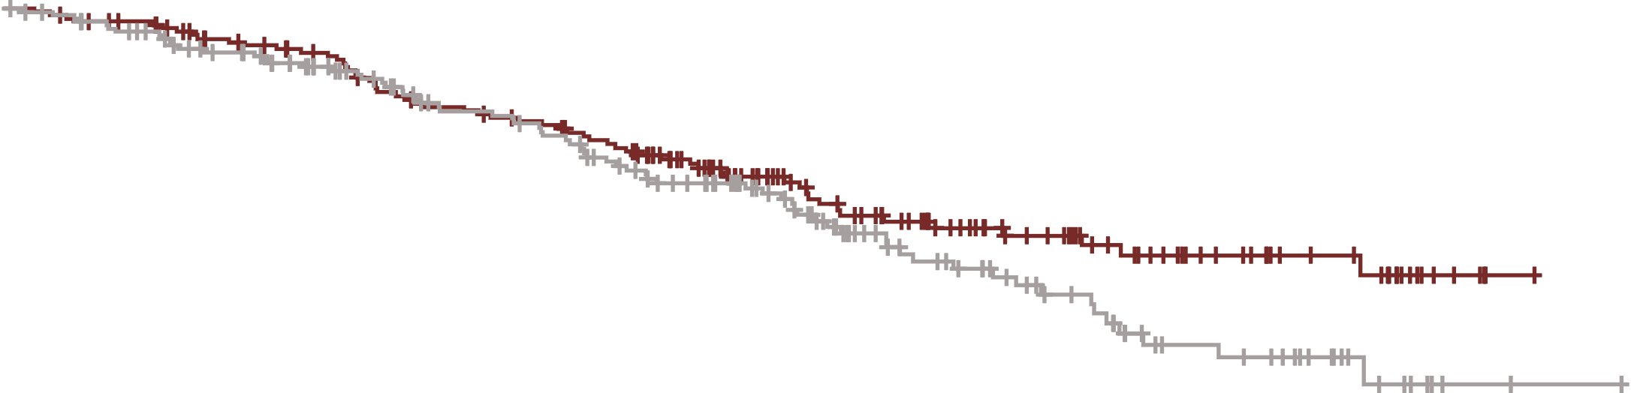
COMMANDS: overall survival (> 2.5 years of follow-up)
Overall survivalª (ITT population)
Luspatercept
Epoetin alfa
No. at risk
Luspatercept
Epoetin alfa
182
181
173
166
154
144
135
120
124
109
95
87
68
55
49
39
33
24
20
17
8
5
1
 | Luspatercept | Epoetin alfa | HR (95% CI)^{c}
Median OS,^{b} months | NR | 46.0 | 0.805 (0.565–1.146)
Data cutoff: February 7, 2025. Median (range) follow-up was 30.6 (1–65) months for luspatercept and 28.8 (0–69) months for epoetin alfa.
NR, not reached. ªOS was defined as the time between randomization and death of any cause. ^{b}Median was from unstratified Kaplan-Meier method. ^{c}HR (95% CI) was calculated by stratified Cox proportional hazard model.

Slide 8
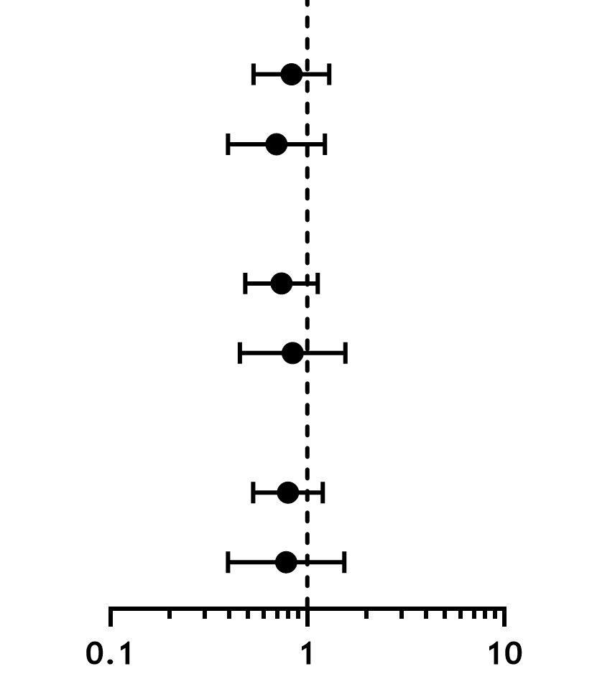
COMMANDS: subgroup analysis of overall survival (> 2.5 years of follow-up)
 | Luspatercept |  | Epoetin alfa |  | HR (95% CI)^{b}
 | Deaths, n/N (%) | Median OSª (months) | Deaths, n/N (%) | Median OSª (months)
Baseline TB (pRBC U/8 weeks)
< 4 | 39/118 (33.1) | NR | 39/111 (35.1) | 46.7 |  | 0.830 (0.532-1.294)
≥ 4 | 20/64 (31.3) | NR | 30/70 (42.9) | 46.0 |  | 0.696 (0.395-1.227)
RS status
RS+ | 41/133 (30.8) | NR | 45/130 (34.6) | 47.2 |  | 0.739 (0.484-1.130)
RS– | 18/49 (36.7) | NR | 23/50 (46.0) | 33.5 |  | 0.842 (0.454-1.561)
Baseline sEPO (U/L)
≤ 200 | 45/145 (31.0) | NR | 48/144 (33.3) | 48.2 |  | 0.797 (0.530-1.197)
> 200 | 14/37 (37.8) | 39.4 | 21/37 (56.8) | 34.8 |  | 0.781 (0.396-1.540)
Favors luspatercept
Favors epoetin alfa
Data cutoff: February 7, 2025. Median (range) follow-up was 30.6 (1-65) months for luspatercept and 28.8 (0-69) months for epoetin alfa. ªMedian was from unstratified Kaplan-Meier method. ^{b}HR was calculated by unstratified Cox proportional hazard model.

Slide 9
COMMANDS: landmark analysis of overall survival (≥ 36 months)
Landmark analysis of overall survivalª from 36 months after randomization
Luspatercept
Epoetin alfa
No. at risk
Luspatercept
Epoetin alfa
68
55
49
39
33
24
20
17
8
5
1
 | Luspatercept | Epoetin alfa | HR (95% CI)^{c}
Median OS,^{b} months | NR | NR | 0.330 (0.128–0.852); P = 0.0161
Data cutoff: February 7, 2025. Median (range) follow-up was 30.6 (1-65) months for luspatercept arm and 28.8 (0-69) months for epoetin alfa. ªOS was defined as the time between the landmark (i.e., 36 months after randomization) and death of any cause. ^{b}Median was from unstratified Kaplan-Meier method. ^{c}HR (95% CI) was calculated by stratified Cox proportional hazard model. P value was from stratified log-rank test.

Slide 10
COMMANDS: RBC-TI ≥ 12 weeks (Week 1-EOT) (> 2.5 years of follow-up)
 | Luspatercept | Epoetin alfa | ORª/HR^{b} (95% CI)
RBC-TI ≥ 12 weeks response rate, % (n/N) | 76.4 (139/182) | 55.8 (101/181) | OR, 2.8 (1.7-4.5); P < 0.0001
Median (95% CI) duration,^{c} weeks Duration of the longest RBC-TI ≥ 12-week period^{d} Cumulative duration of RBC-TI ≥ 12 weeks^{e} | 126.6 (81.0-154.1) 150.0 (119.6-256.0) | 86.7 (55.9-105.9) 95.1 (74.9-180.1) | HR, 0.632 (0.434-0.919); P = 0.0156 HR, 0.523 (0.353-0.777); P = 0.0011
Cumulative duration of
RBC-TI ≥ 12 weeks (ITT population)^{e}
Luspatercept
Epoetin alfa
Censored
+
No. at risk
Luspatercept
Epoetin alfa
139
101
128
86
112
76
101
66
93
57
89
52
83
46
78
39
72
36
64
32
62
28
55
27
49
21
42
20
33
17
31
17
28
15
24
15
18
12
14
10
14
7
14
5
13
4
8
4
7
3
5
3
3
1
1
139
101
1
Data cutoff: February 7, 2025. Median (range) follow-up was 30.6 (1-65) months for luspatercept and 28.8 (0-69) months for epoetin alfa.
EOT, end of treatment; OR, odds ratio.
ªBased on Cochran–Mantel–Haenszel test stratified by baseline RBC TB, RS status, and sEPO levels. One-sided P value is presented. ^{b}HR was calculated by stratified Cox proportional hazard model. P value was from stratified log-rank test. ^{c}Median was from unstratified Kaplan-Meier method. ^{d}Duration of RBC-TI ≥ 12 weeks was defined as the longest RBC-TI period from Week 1 to EOT. ^{e}Cumulative duration was defined as the sum of all durations of RBC-TI ≥ 12-week episodes from Week 1 through EOT.

Slide 11
COMMANDS: cumulative duration of RBC-TI ≥ 12 weeks (Week 1-EOT) by baseline transfusion burden (> 2.5 years of follow-up)
Cumulative duration of RBC-TI ≥ 12 weeks (ITT population)ª
< 4 RBC U/8 weeks
≥ 4 RBC U/8 weeks
Luspatercept
Epoetin alfa
Censored
Luspatercept
Epoetin alfa
Censored
+
+
No. at risk
Luspatercept
Epoetin alfa
100
77
100
77
92
66
85
59
76
51
70
44
67
39
62
33
57
28
53
26
45
23
44
21
38
21
33
16
28
16
22
13
20
13
17
13
15
13
12
10
10
8
10
5
10
4
9
4
5
4
4
3
3
3
2
1
0
1
1
0
No. at risk
Luspatercept
Epoetin alfa
39
24
39
24
36
20
27
17
25
15
23
13
22
13
21
13
21
11
19
10
19
9
18
7
17
6
16
5
14
4
11
4
11
4
11
2
9
2
6
2
4
2
4
2
4
1
4
0
3
3
2
1
0
Median (95% CI) duration,^{b} weeks | Luspatercept | Epoetin alfa | HR (95% CI)^{c}
< 4 RBC U/8 weeks | 141.9 (119.6–NE) | 95.1 (66.7–186.1) | 0.671 (0.438–1.028)
≥ 4 RBC U/8 weeks | 184.4 (66.9–NE) | 110.9 (33.9–NE) | 0.687 (0.332–1.421)
Data cutoff: February 7, 2025. Median (range) follow-up was 30.6 (1-65) months for luspatercept and 28.8 (0-69) months for epoetin alfa.
NE, not estimable.
ªCumulative duration was defined as the sum of all durations of RBC-TI ≥ 12 weeks episodes from Week 1 through EOT. ^{b}Median was from unstratified Kaplan-Meier method. ^{c}HR was calculated by unstratified Cox proportional hazard model.

Slide 12
COMMANDS: cumulative duration of RBC-TI ≥ 12 weeks (Week 1-EOT) by RS status (> 2.5 years of follow-up)
Cumulative duration of RBC-TI ≥ 12 weeks (ITT population)ª
RS+
RS–
Luspatercept
Epoetin alfa
Censored
Luspatercept
Epoetin alfa
Censored
+
+
No. at risk
Luspatercept
Epoetin alfa
109
67
109
67
102
57
88
49
79
40
72
32
70
29
67
25
62
24
57
21
51
18
49
17
45
16
40
12
35
11
28
10
27
10
24
9
20
9
14
6
11
4
11
3
11
3
10
3
6
3
5
2
3
2
1
1
0
1
1
0
No. at risk
Luspatercept
Epoetin alfa
30
34
30
34
26
29
24
27
22
26
21
25
19
23
16
21
16
15
15
15
13
14
13
11
10
11
9
9
7
9
5
7
4
7
4
6
4
6
4
6
3
6
3
4
3
2
3
1
2
1
2
1
2
1
2
0
0
Median (95% CI) duration,^{b} weeks | Luspatercept | Epoetin alfa | HR (95% CI)^{c}
RS+ | 126.6 (93.0–235.9) | 73.1 (41.6–110.9) | 0.614 (0.413–0.914)
RS- | NE (135.9–NE) | 205.1 (95.1–NE) | 0.531 (0.184–1.530)
Data cutoff: February 7, 2025. Median (range) follow-up was 30.6 (1-65) months for luspatercept and 28.8 (0-69) months for epoetin alfa.
RS, ring sideroblast.
ªCumulative duration was defined as the sum of all durations of RBC-TI ≥ 12 weeks episodes from Week 1 through EOT. ^{b}Median was from unstratified Kaplan-Meier method. ^{c}HR was calculated by unstratified Cox proportional hazard model.

Slide 13
COMMANDS: cumulative duration of RBC-TI ≥ 12 weeks (Week 1-EOT) by baseline sEPO (> 2.5 years of follow-up)
Cumulative duration of RBC-TI ≥ 12 weeks (ITT population)ª
sEPO ≤ 200 U/L
sEPO > 200 U/L
Luspatercept
Epoetin alfa
Censored
Luspatercept
Epoetin alfa
Censored
+
+
No. at risk
Luspatercept
Epoetin alfa
119
94
119
94
111
81
101
73
91
63
85
54
81
49
75
43
71
36
66
34
59
30
57
26
51
25
45
20
39
19
31
16
29
16
27
15
23
15
17
12
13
10
13
7
13
5
12
4
7
4
6
3
4
3
2
1
0
1
1
0
No. at risk
Luspatercept
Epoetin alfa
20
7
20
7
17
5
11
3
10
3
8
3
8
3
8
3
7
3
6
2
5
2
5
2
4
2
4
1
3
1
2
1
2
1
1
0
1
1
1
1
1
1
1
1
1
1
0
Median (95% CI) duration,^{b} weeks | Luspatercept | Epoetin alfa | HR (95% CI)^{c}
sEPO ≤ 200 U/L | 187.3 (125.7–NE) | 101.4 (74.9–180.1) | 0.621 (0.417–0.924)
sEPO > 200 U/L | 48.3 (26.3–132.6) | 24.6 (14.9–NE) | 0.804 (0.286–2.265)
Data cutoff: February 7, 2025. Median (range) follow-up was 30.6 (1-65) months for luspatercept and 28.8 (0-69) months for epoetin alfa.
ªCumulative duration was defined as the sum of all durations of RBC-TI ≥ 12 weeks episodes from Week 1 through EOT. ^{b}Median was from unstratified Kaplan-Meier method. ^{c}HR was calculated by unstratified Cox proportional hazard model.

Slide 14
COMMANDS: summary of safety (> 2.5 years of follow-up)
 | Luspatercept (n = 182) |  | Epoetin alfa (n = 179)
 | n (%) | EAIR/100 PYª | n (%) | EAIR/100 PYª
Patients with ≥ 1 treatment-emergent EOI^{b} | 125 (68.7) | 73.7 | 97 (54.2) | 69.6
Asthenia (including fatigue, malaise, and lethargy) | 63 (34.6) | 25.9 | 48 (26.8) | 27.1
Hypertension | 32 (17.6) | 11.8 | 19 (10.6) | 9.6
Malignancies | 22 (12.1) | 7.1 | 16 (8.9) | 7.8
Fractures | 20 (11.0) | 6.7 | 23 (12.8) | 11.2
Kidney toxicity | 20 (11.0) | 6.7 | 13 (7.3) | 6.4
Premalignant disorders | 13 (7.1) | 4.1 | 14 (7.8) | 6.5
Immunogenicity hypersensitivity type reactions | 10 (5.5) | 3.2 | 3 (1.7) | 1.4
Liver toxicity | 7 (3.8) | 2.2 | 6 (3.4) | 2.8
Immunogenicity injection local type reactions | 5 (2.7) | 1.6 | 1 (0.6) | 0.5
EMH masses | 1 (0.5) | 0.3 | 0 | 0
Data cutoff: February 7, 2025. Median (range) follow-up was 30.6 (1-65) months for luspatercept and 28.8 (0-69) months for epoetin alfa. Median treatment duration (range) was 71.5 (3-276) weeks for luspatercept and 44.0 (1-299) weeks for epoetin alfa.
EAIR, exposure-adjusted incidence rate; EMH, extramedullary hematopoiesis; EOI, event of interest; PY, person-year.
ªEAIR/100 PY is 100 times the number of patients with the specific treatment-emergent EOI divided by the total exposure time (in years) to the event. Exposure time was the overall treatment exposure for patients without an event and the time up to the first event start date for patients with the event. ^{b}Among the safety population, defined as all randomized patients who received ≥ 1 dose of study treatment (and by treatment received).

Slide 15
COMMANDS: summary of disease progression (> 2.5 years of follow-up)
 | Luspatercept (n = 182) | Epoetin alfa (n = 179)
Progression to HR-MDS,ª n (%) | 4 (2.2) | 10 (5.6)
HR-MDS incidence rate per 100 PY^{b} (95% CI) | 0.85 (0.32-2.26) | 2.41 (1.30-4.48)
HR (95% CI)^{c} | 0.388 (0.120-1.250); P = 0.1003
Median time to HR-MDS progression from treatment start date (95% CI), months | NE (NE–NE) | NE (NE–NE)
Progression to AML,^{d} n (%) | 9 (4.9) | 8 (4.4)
AML incidence rate per 100 PY^{b} (95% CI) | 1.91 (1.00–3.68) | 1.91 (0.95–3.81)
HR (95% CI)^{c} | 1.110 (0.420–2.932); P = 0.8326
Median time to AML progression from initial MDS diagnosis (95% CI), months | NE (132.1–NE) | NE (NE–NE)
Data cutoff: February 7, 2025. Median (range) follow-up was 30.6 (1-65) months for luspatercept and 28.8 (0-69) months for epoetin alfa.
ªHigher-risk category comprises high- and very high-risk categories per IPSS-R. ^{b}PY was calculated from the treatment start date to the HR-MDS onset date or from the randomization date to AML onset date, or to the last follow-up date for patients without progression to HR-MDS or AML. ^{c}HR (95% CI) was calculated by stratified Cox proportional hazard model, P value was calculated from stratified log-rank test. ^{d}Based on ITT population.

Slide 16
COMMANDS: summary
In this first report of OS for the COMMANDS trial, patients who received luspatercept showed a trend for improved survival versus epoetin alfa, with median OS not reached for luspatercept and a 20% lower risk of death compared with patients treated with epoetin alfa
The positive OS trend with luspatercept was observed across prespecified subgroups, including high baseline transfusion burden, RS-, and low sEPO populations
Extended follow-up is ongoing
At a median follow-up of > 2.5 years, luspatercept continued to improve response rate and offered a longer duration of response versus epoetin alfa
Significantly more patients achieved RBC-TI ≥ 12 weeks (OR, 2.8) with luspatercept versus epoetin alfa
Median cumulative duration of RBC-TI ≥ 12 weeks was ~1 year longer with luspatercept versus epoetin alfa
Safety results remained consistent with the known safety profile of luspatercept in MDS
Fewer patients in the luspatercept arm progressed to HR-MDS compared with epoetin alfa
To date, COMMANDS is the first prospective, randomized, head-to-head phase 3 trial in first-line LR-MDS to show a positive trend in improving OS compared to ESAs
These long-term results support luspatercept as the standard of care for anemia in first-line transfusion-dependent LR-MDS, providing prolonged responses and the potential for extended survival

Slide 17


Acknowledgments
The patients and families who made the study possible
The clinical study teams who participated
Study drugs were provided by Bristol Myers Squibb (Princeton, NJ, USA)
The study was supported by Celgene, a Bristol Myers Squibb Company, in collaboration with Acceleron Pharma Inc., a wholly owned subsidiary of Merck & Co., Inc., Rahway, NJ, USA
All authors contributed to and approved the presentation
Writing and editorial assistance were provided by Alex Dimitri, PhD, of Lumanity Communications Inc., and were funded by Bristol Myers Squibb
Scientific content on demand
Copies of this presentation obtained through Quick Response (QR) Code are for personal use only and may not be reproduced without permission from the authors of this presentation.
PLACEHOLDER
www.globalbmsmedinfo.com

